Slide 1


OBJECT ORIENTED PROGRAMMING THROUGH JAVA

Slide 2

L2 - HISTORY OF JAVA

Slide 3


Slide 4
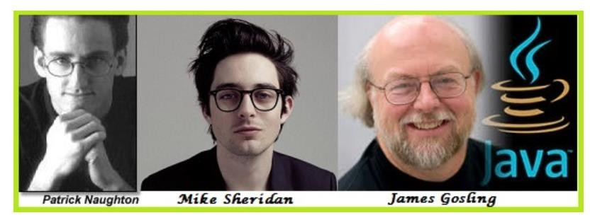
HISTORY OF JAVA:-
In 1990, Sun Micro Systems Inc. (US) was conceived a project to develop software for consumer electronic devices that could be controlled by a remote. This project was called Stealth Project but later its name was changed to Green Project.
In January 1991, Project Manager James Gosling and his team members Patrick Naughton, Mike Sheridan, Chris Wrath, and Ed Frank met to discuss about this project.

Slide 5
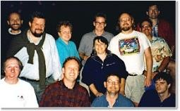
GREEN TEAM

Slide 6
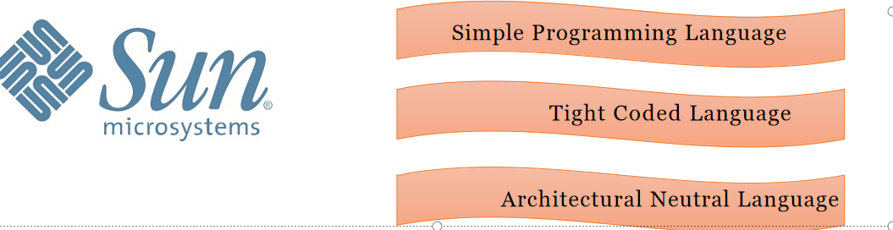
HISTORY OF JAVA:-
Gosling thought C and C++ would be used to develop the project. But the problem he faced with them is that they were system dependent languages. The trouble with C and C++ (and most other languages) is that they are designed to be compiled for a specific target and could not be used on various processors, which the electronic devices might use.

Slide 7

HISTORY OF JAVA:-
James Gosling with his team started developing a new language, which was completely system independent. This language was initially called OAK.

Slide 8
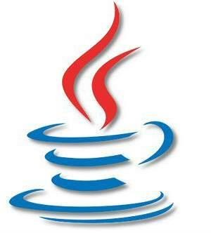
Since this name was registered by some other company, later it was changed to Java. The language was renamed, Java, after Oak Technology raised a legal challenge and the language was used to implement a web browser - HotJava.
James Gosling and his team members were consuming a lot of coffee while developing this language. Good quality of coffee was supplied from a place called “Java Island’. Hence they fixed the name of the language as Java. The symbol for Java language is cup and saucer.

Slide 9
Next….
JAVA BUZZWORDS
Notes:
In Slide Show mode, click the arrow to enter the PowerPoint Getting Started Center.

Slide 10



